Slide 1
Random Matrices and the Stock Market
A preliminary EDA
Hugo C Marrochio

Slide 2
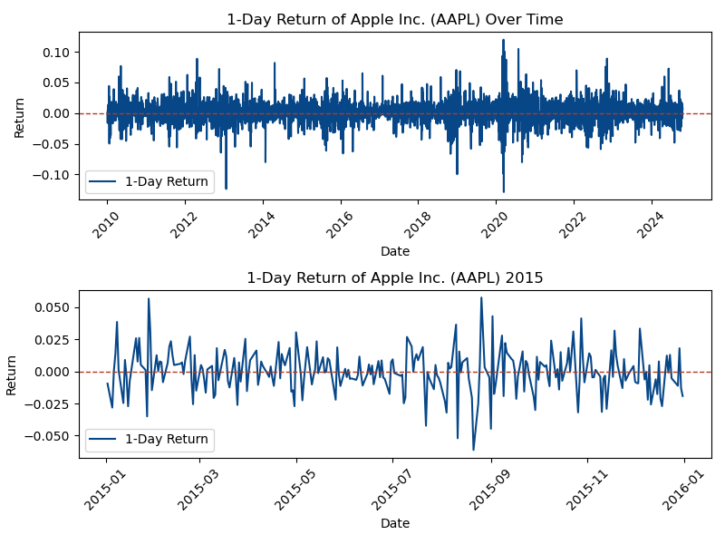
Dataset - S&P Stock Market
S&P 500 (Standard and Poor) stock data
https://www.kaggle.com/datasets/andrewmvd/sp-500-stocks
Top 503 stocks being traded is US
Example: Daily return for Apple stock
$\text{Return}:\frac{P_{t}-P_{t-1}}{P_{t-1}}$
Complicated time series, hard to make predictions!

Slide 3
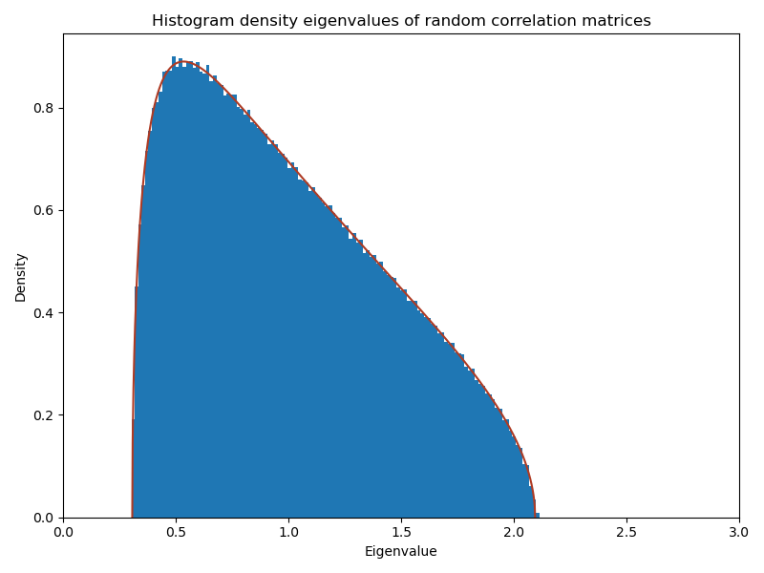
Properties of Random Matrix Theory (RMT)
Rich subject with many applications in mathematics and physics
A surprising property: In a certain limit, the eigenvalues of the correlation of random matrices follow a specific pdf (Marcenko-Pastur)
Can use this fact to investigate randomness!!!
Goal: “Denoise” correlation, cluster algorithms between stocks and forecast models if time permits

Slide 4
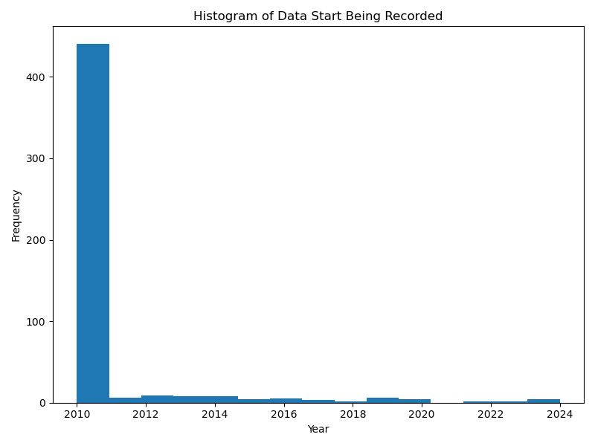
More about our data - Null Values
Subtlety about the data: sometimes null values make sense!
A stock is not going to have a market value before it was created!
Since we have 503 stocks, we can always select ones (~85% no null)

Slide 5
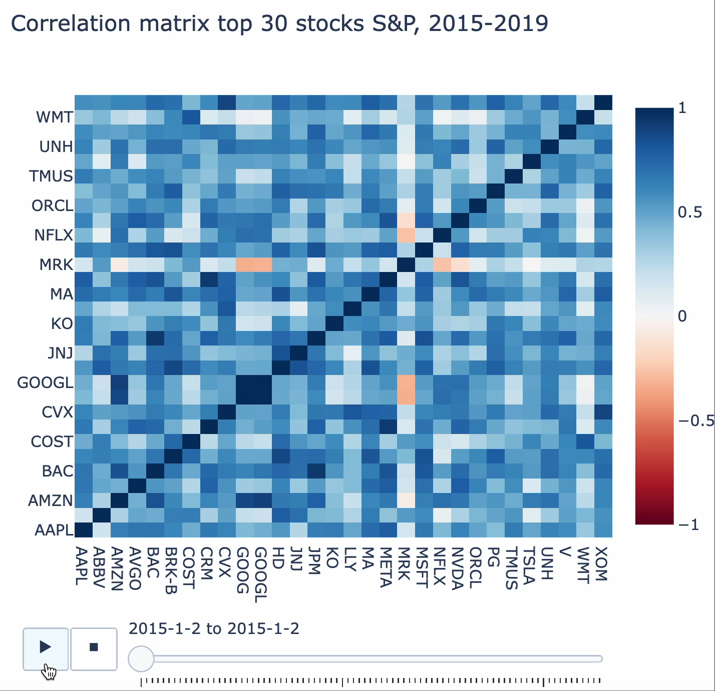
Correlation
Our main object of study will be correlation matrices
Difficulty with identifying trends in stock; signal and noise coexist.
Find a good balance between averaging time window and number of stocks selected

Slide 6
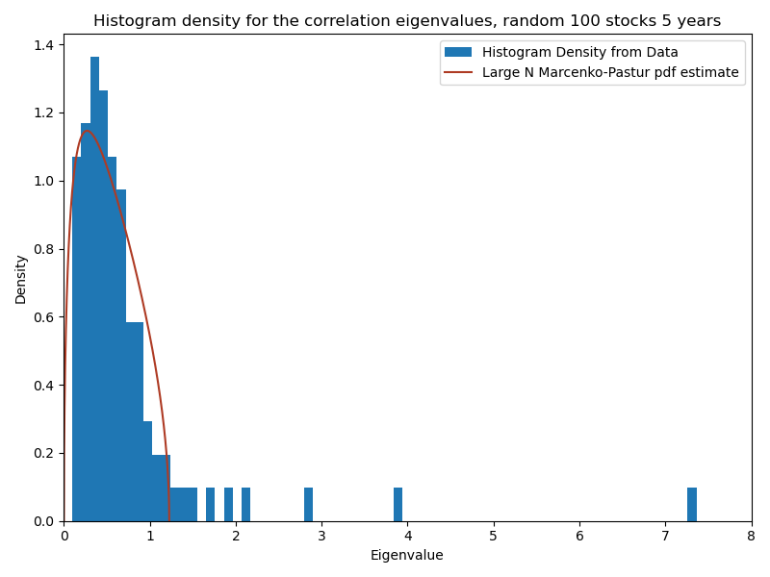
Preliminary Eigenvalue Investigation
Can use RMT expectation to set a range of “random” eigenvalues.
There are some subtleties in the analysis that I plan to explore further.
Influence of time averages, stock portfolio size, RMT fit hyper parameters.

Slide 7
Plan of Action
Next step: Consolidate the time scale, investigate the optimization for the RMT fit
Cluster algorithms taking into consideration “denoising” from the “random” eigenvalues
If time permits, investigate simple AI models to forecast with the cluster information
Reinforcement learning?

